Slide 1
Jesus’ Teaching on Prayer

Slide 2
Mark 11 v 12 - 25
Jesus Curses the Fig Tree
¹² On the following day, when they came from Bethany, he was hungry. ¹³ And seeing in the distance a fig tree in leaf, he went to see if he could find anything on it. When he came to it, he found nothing but leaves, for it was not the season for figs. ¹⁴ And he said to it, “May no one ever eat fruit from you again.” And his disciples heard it.

Slide 3
Mark 11 v 12 - 25
Jesus Cleanses the Temple
¹⁵ And they came to Jerusalem. And he entered the temple and began to drive out those who sold and those who bought in the temple, and he overturned the tables of the money-changers and the seats of those who sold pigeons. ¹⁶ And he would not allow anyone to carry anything through the temple. ¹⁷ And he was teaching them and saying to them, “Is it not written, ‘My house shall be called a house of prayer for all the nations’? But you have made it a den of robbers.” ¹⁸ And the chief priests and the scribes heard it and were seeking a way to destroy him, for they feared him, because all the crowd was astonished at his teaching. ¹⁹ And when evening came they^{[b]} went out of the city.

Slide 4
Mark 11 v 12 - 25
The Lesson from the Withered Fig Tree
²⁰ As they passed by in the morning, they saw the fig tree withered away to its roots. ²¹ And Peter remembered and said to him, “Rabbi, look! The fig tree that you cursed has withered.” ²² And Jesus answered them, “Have faith in God. ²³ Truly, I say to you, whoever says to this mountain, ‘Be taken up and thrown into the sea’, and does not doubt in his heart, but believes that what he says will come to pass, it will be done for him. ²⁴ Therefore I tell you, whatever you ask in prayer, believe that you have received^{[c]} it, and it will be yours. ²⁵ And whenever you stand praying, forgive, if you have anything against anyone, so that your Father also who is in heaven may forgive you your trespasses.”^{[d]}

Slide 5
Matthew 7 v 7 -11
Ask, and It Will Be Given
⁷ “Ask, and it will be given to you; seek, and you will find; knock, and it will be opened to you. ⁸ For everyone who asks receives, and the one who seeks finds, and to the one who knocks it will be opened. ⁹ Or which one of you, if his son asks him for bread, will give him a stone? ¹⁰ Or if he asks for a fish, will give him a serpent? ¹¹ If you then, who are evil, know how to give good gifts to your children, how much more will your Father who is in heaven give good things to those who ask him!

Slide 6
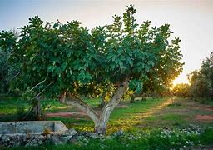

Slide 7
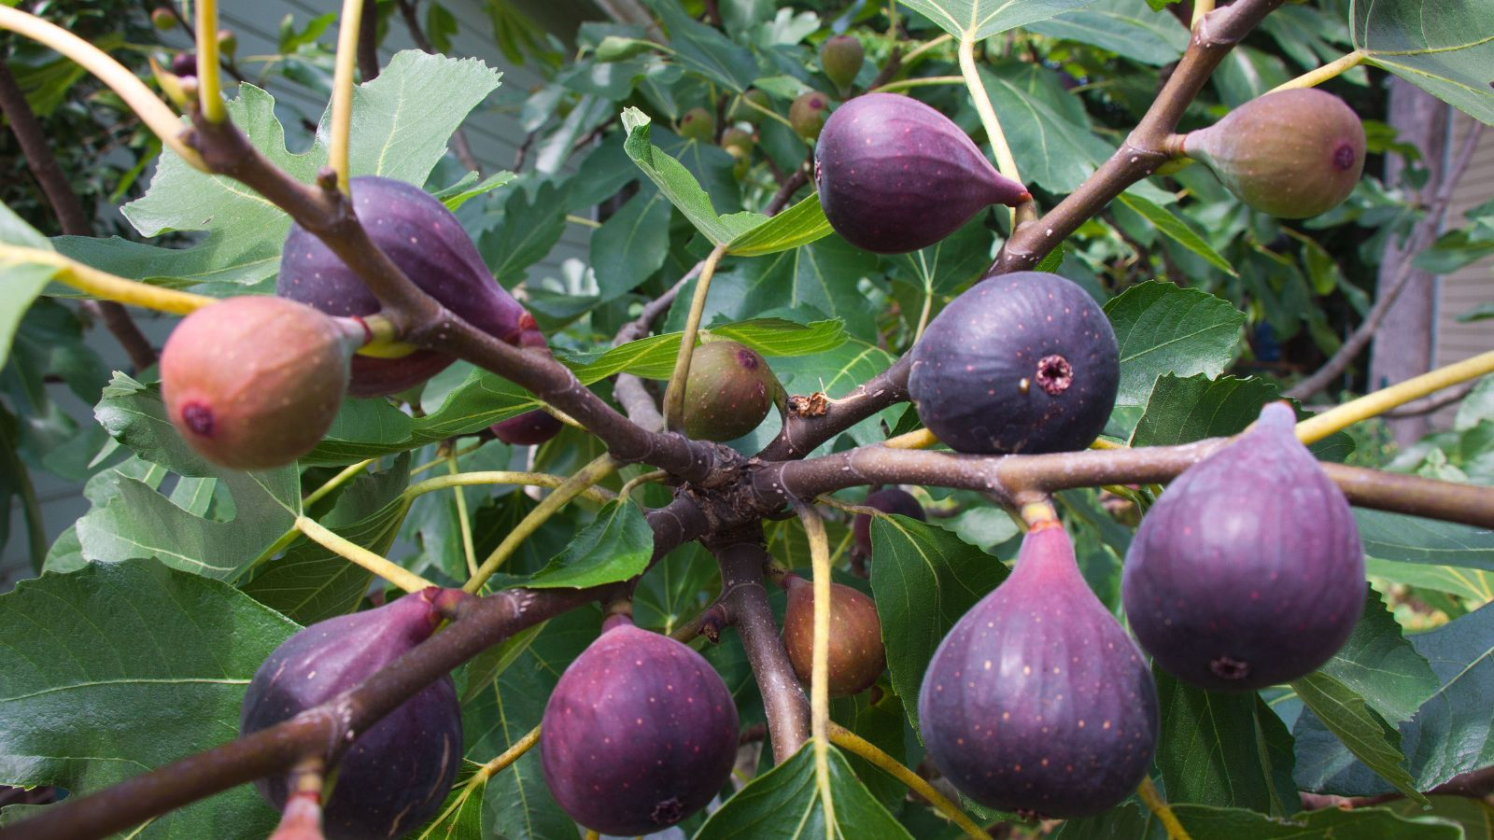

Slide 8
Mark 11 v 11
¹¹ And he entered Jerusalem and went into the temple. And when he had looked around at everything, as it was already late, he went out to Bethany with the twelve.

Slide 9
John 1 v 1
In the beginning was the Word, and the Word was with God, and the Word was God. 2 He was in the beginning with God. 3 All things were made through him, and without him was not anything made that was made.

Slide 10
Exodus 33 v 19 - 20
19 And he said, “I will make all my goodness pass before you and will proclaim before you my name ‘The LORD’. And I will be gracious to whom I will be gracious, and will show mercy on whom I will show mercy. 20 But,” he said, “you cannot see my face, for man shall not see me and live.”

Slide 11
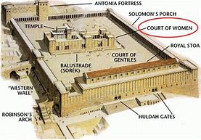

Slide 12
Psalm 7 v 11
God is a righteous judge,
and a God who feels indignation every day.

Slide 13
Isaiah 56 v 6 - 7
6 “And the foreigners who join themselves to the LORD,
to minister to him, to love the name of the LORD,
and to be his servants,
everyone who keeps the Sabbath and does not profane it,
and holds fast my covenant—
7 these I will bring to my holy mountain,
and make them joyful in my house of prayer;
their burnt offerings and their sacrifices
will be accepted on my altar;
for my house shall be called a house of prayer
for all peoples.”

Slide 14
James 2 v 19
19 You believe that God is one; you do well. Even the demons believe—and shudder!

Slide 15
Mark 11 v 23-24
23 Truly, I say to you, whoever says to this mountain, ‘Be taken up and thrown into the sea’, and does not doubt in his heart, but believes that what he says will come to pass, it will be done for him. 24 Therefore I tell you, whatever you ask in prayer, believe that you have received it, and it will be yours.

Slide 16
Matthew 7 v 7 -11
Ask, and It Will Be Given
⁷ “Ask, and it will be given to you; seek, and you will find; knock, and it will be opened to you. ⁸ For everyone who asks receives, and the one who seeks finds, and to the one who knocks it will be opened. ⁹ Or which one of you, if his son asks him for bread, will give him a stone? ¹⁰ Or if he asks for a fish, will give him a serpent? ¹¹ If you then, who are evil, know how to give good gifts to your children, how much more will your Father who is in heaven give good things to those who ask him!

Slide 17
Luke 15 v 8
8 “Or what woman, having ten silver coins,[a] if she loses one coin, does not light a lamp and sweep the house and seek diligently until she finds it?

Slide 18
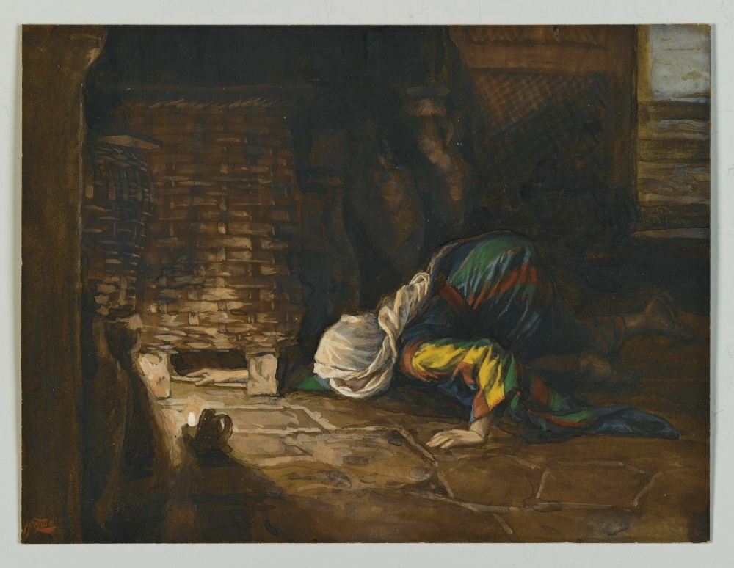

Slide 19
Matthew 13 v 45
45 “Again, the kingdom of heaven is like a merchant in search of fine pearls, 46 who, on finding one pearl of great value, went and sold all that he had and bought it.

